Slide 1
Lesson 4: Durham Report

Slide 2
Result of the Rebellions: Lord Durham Report
Insurrection: a crime that involves revolting against the established government.
Death penalty warranted because they followed British Law.
New Governor came in called (John Lambton)Lord Durham
Ignored the Family Compact’s way of governing and compiled a report on why the Rebellions took place.

Slide 3
Durham’s Contributions to BNA
British North America= Upper Canada & Lower Canada
Pros:
-Patched relations with the U.S. (stopped rebels from their plans on invading Canada).
- treated captured rebels as leniently as possible.
Cons: -prejudiced against the French
- Dictator without the support of the Family Compact bodies.

Slide 4
The Report:
Recommended executive council to be chosen by members of the Legislative Assembly➔ creating the future Cabinet of Canada
Recommended that Legislative council will no longer have the power to make laws→ turned into future Senate of Canada
Recommended that Upper and Lower Canada join together→ inspired the Act of Union in 1840 with Montreal being the capital. (without French support though—created problems)

Slide 5
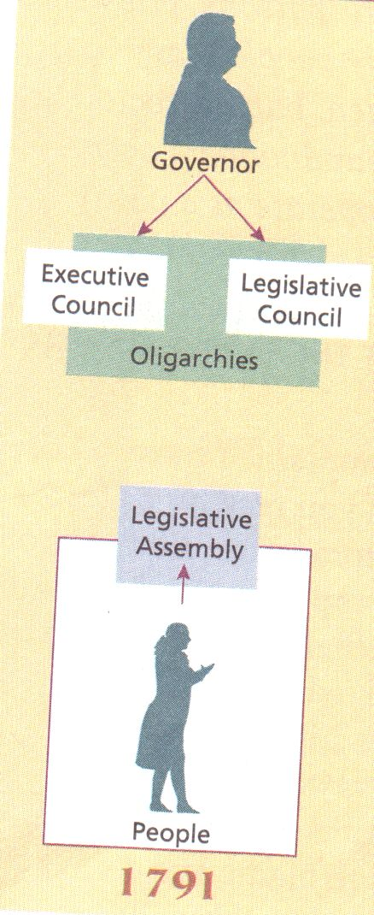
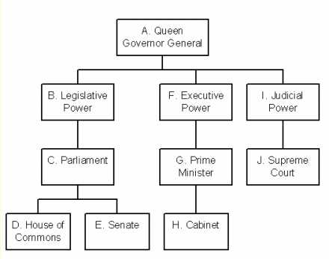

Slide 6
Victorian Lifestyles

Slide 7
Fashion & Decor
Long dresses and aprons for poor women
Hats and ties for men poor
Finest cloth for wealthy women
Long jackets for wealthy men
Tanned people means you’re in lower class
Rich= huge houses
Large houses were heated.
Loved heavy decorated furniture. Poor cannot afford it.

Slide 8
Science and Medicine
They thought germs came out of insect eggs
First seen in 1870s under a microscope
Aspirin antibiotics antiseptics and hormones were discovered in later half of century
Doctor had very little hygiene and infect patients instead of helping them (this happened in surgery rooms—they used to smoke while operating on a patient)
Vaccinations became available in Victorian Era
Louis Pasteur discovered baccili and he cured smallpox using carbolic acid
Numerous women died during childbirth due to unsterile conditions, too poor to afford a midwife

Slide 9
Leisure and Travel
Visited parties concerts fairs and shows in cities
Countryside= barn raisings, wedding parties, music, and barn dances
Dog and bull fighting, bear-baiting, bare-knuckle boxing
No tv or radio, no movies videos or recorded music==held dances, parlour games, whist, checkers and chess
Pulling up the stump, pulling the leg, kissing his thumb for strength and coordination
People wanted to travel overseas to do stuff—transatlantic voyages take up less time (e.g. 17 days).
Locomotive became popular; eventually created railways that travelled around Canada.—people and goods

Slide 10
Newspapers
1 or more newspapers in mid-19th century
Newspapers existed in Canada since 18th century
Newspaper only source of news from outside the world
First newspaper was founded in 1752
Canada had 47 dailys---a newspaper thats published everyday
Newspaper was the only way to assess the information
There was no sports section

