Slide 1
Lesson 4: Durham Report

Slide 2
Result of the Rebellions: Lord Durham Report
Insurrection: a crime that involves revolting against the established government.
Death penalty warranted because they followed British Law.
New Governor came in called (John Lambton)Lord Durham
Ignored the Family Compact’s way of governing and compiled a report on why the Rebellions took place.

Slide 3
Durham’s Contributions to BNA
British North America= Upper Canada & Lower Canada
Pros:
-Patched relations with the U.S. (stopped rebels from their plans on invading Canada).
- treated captured rebels as leniently as possible.
Cons: -prejudiced against the French
- Dictator without the support of the Family Compact bodies.

Slide 4
The Report:
Recommended executive council to be chosen by members of the Legislative Assembly➔ creating the future Cabinet of Canada
Recommended that Legislative council will no longer have the power to make laws→ turned into future Senate of Canada
Recommended that Upper and Lower Canada join together→ inspired the Act of Union in 1840 with Montreal being the capital. (without French support though—created problems)

Slide 5
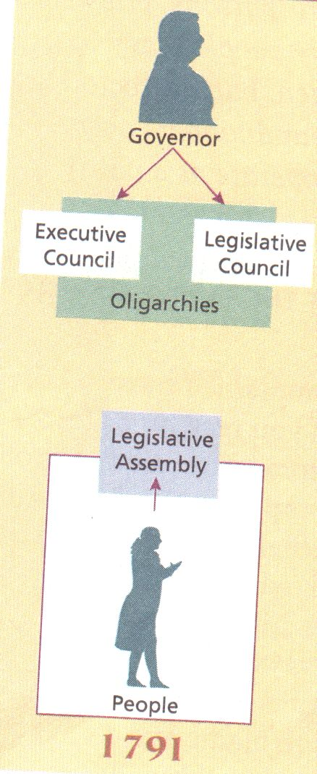
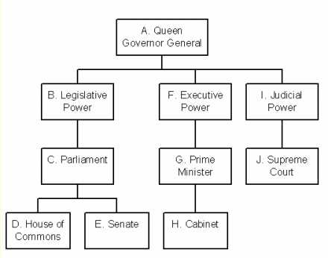

Slide 6
Victorian Lifestyles

Slide 7
Fashion & Decor
Indicated social status and victorian values---fashion and decor
Women= long dresses, aprons
Men= hats and ties
Rich men= long jackets and high stiff collars
Rich women= long dresses made from the finest cloth
Tanned= poor
Parasols
Broad brimmed hats
Victorians most demonstrated about wealth
Large houses= wealth show off.
Heavy decorated furniture if you can afford it.

Slide 8
Science and Medicine
Many discoveries were made by scientists and adventurers that there wasn’t a lack of information
Vaccinations became available to ordinary people
Doctors infected their patients
Antiseptics not yet discovered. They didn’t wash their hands or their instruments.
Aspirin, antibiotics, antiseptics, and hormones weren’t discovered until 19th century

Slide 9
Leisure and Travel
Victorian canadians like to be entertained
Parties concerts fairs circusses and shows in cities
Stories were published in serial format to continue people’s interest
Locomotives and steam ships= technology
First railroad was champlain st. Lawrence railroad.
4 types of games, whist, pulling the stump, pulling the leg, and kissing his thumb

Slide 10
Newspapers
First newspaper founded in 1752
Newspaper became popular in the mid 19th century and published everyday
More newspapers made because most people can read
Many people lived in cities so access to information was important
No sports news, no horoscopes, no comics except politcal cartoons
No privacy in reporting news
Court reports names of offenders and publish in newspaper
Breaking news are late.
Newspapers were revolutionary and reshaped society

