Slide 1
Lesson 4: Durham Report

Slide 2
Result of the Rebellions: Lord Durham Report
Insurrection: a crime that involves revolting against the established government.
Death penalty warranted because they followed British Law.
New Governor came in called (John Lambton)Lord Durham
Ignored the Family Compact’s way of governing and compiled a report on why the Rebellions took place.

Slide 3
Durham’s Contributions to BNA
British North America= Upper Canada & Lower Canada
Pros:
-Patched relations with the U.S. (stopped rebels from their plans on invading Canada).
- treated captured rebels as leniently as possible.
Cons: -prejudiced against the French
- Dictator without the support of the Family Compact bodies.

Slide 4
The Report:
Recommended executive council to be chosen by members of the Legislative Assembly➔ creating the future Cabinet of Canada
Recommended that Legislative council will no longer have the power to make laws→ turned into future Senate of Canada
Recommended that Upper and Lower Canada join together→ inspired the Act of Union in 1840 with Montreal being the capital. (without French support though—created problems)

Slide 5
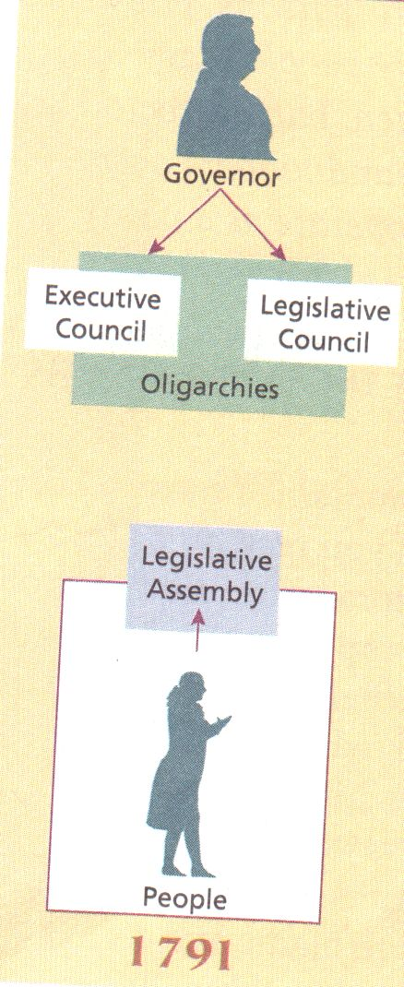
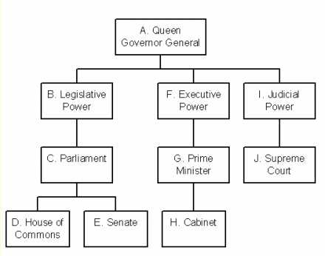

Slide 6
Victorian Lifestyles

Slide 7
Issues:
Similar governing body as The Family Compact: called Le Chateau Clique
Faces French discrimination and inequalities more but has less issues with land distribution problems.

Slide 8
Fashion & Decor
Less formal than europeans
Clothing= social status
Women= long dresses and aprons
Rich Men= long jackets and high stiff collars
Rich Women= finest cloth clothing
Tan= poor
Houses of the rich= large=necessary because large families are common
Love heavy decorated furniture
Rooms cluttered and overdone
Poor lived in small houses---grown children lived with parents even after marriage

Slide 9
Science and Medicine
19th century lots of discoveries from scientists
Origins of disease but didnt understand many of them
Germs first seen in 1870s
Newspapers carries count of discoveries to stir public curiosity
Aspirin, antibiotics, antiseptics, discovered in 19th century
Vaccinations available
Smallpox, typhoid fever, influenza, tuberculosis==children were weakest to them
Women childbirth extremely dangerous
Louis Pasteur found diseases such as anthrax, used carbolic acid to cure.

Slide 10
Leisure and Travel
Went to parties concerts fairs circusses and shows in cities
Barn raisings, attending weddings country
Books and magasines
Bear baiting, dog bull fighting, fist fights
Useless medicine shows, all ailments etc.
Alcohol, intoxicated, high????
No tv or radios, held dances music, whist, checkers, and chess
Technology= steam boats, take 17 days to cross ocean

Slide 11
Newspapers
No professional advice columns, horoscopes, etc.
Did not respect people’s privacy
News important because they want to know what their neighbours are up to
People bought newspapers only if they found them useful or interesting, e.g. Recipes
Late breaking news-
Victorian newspaper looks old fashion
Mid 19th century places in canada have more than 1 newspaper
Halifax gazette= first newspaper 1752

