Slide 1
Shot Skills
An introduction to photography.

Slide 2
Things we will talk about:
Law of Thirds
Extreme long shot
Long shot
Medium shot
Close shot
Extreme close shop
What you need to do

Slide 3
Law of Thirds
This is a general guideline used in most visual art
The screen is divided up into 9 equal parts
3 horizontal lines and 3 vertical lines
The subject or main focus of the shot should be placed at one or more of the line intersections
Subject SHOULD NOT BE CENTERED!

Slide 4
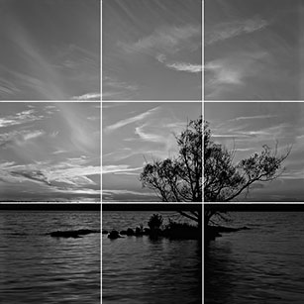

Slide 8
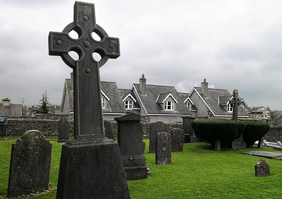

Slide 9
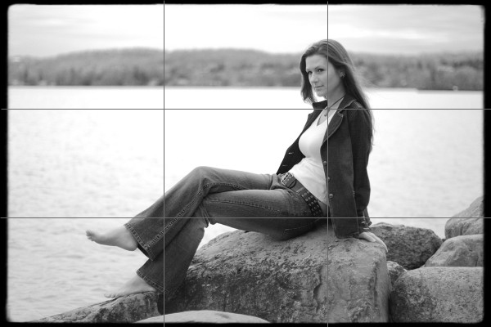

Slide 10
Extreme Long Shot
Used to establish a scene (aka scene setting)
Typically landscape, or exterior of a building
Very little specific detail
Meant to give general impression, rather than information

Slide 12
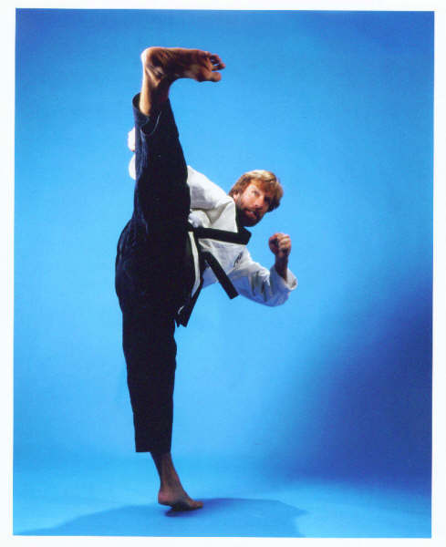
Long Shot
From bottom of feet to top of head
Aka entire body of the subject
Focus is on the character
Still some use of background detail
Used to demonstrate action sequences

Slide 13
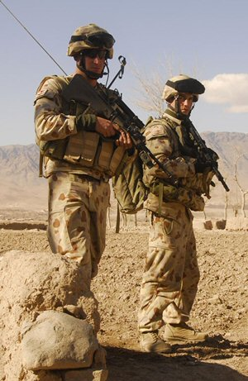

Slide 15
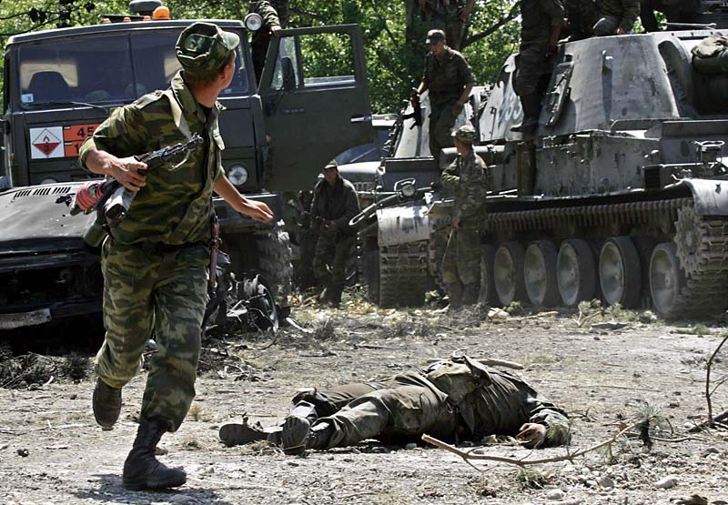

Slide 16
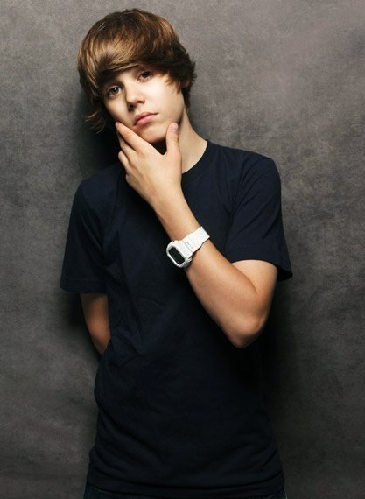
Medium Shot
From Knees/waist to top of head
Normally used for dialog scenes
Can be used to show details of action during action sequence

Slide 17
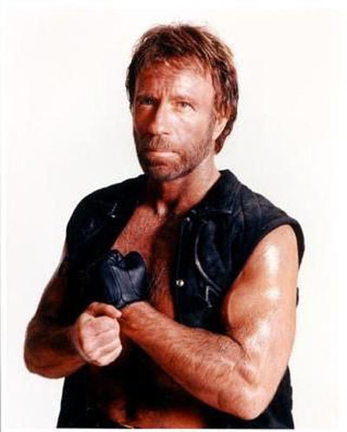

Slide 20
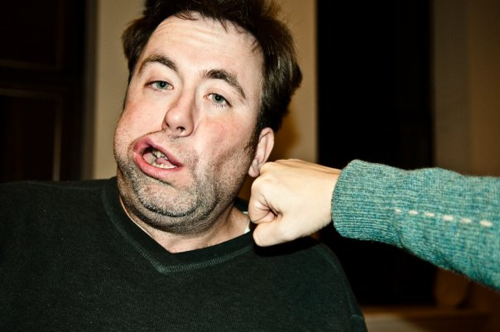
Close up shot
From shoulders to top of head
Focus is on the ‘face’ of the subject
And expression
Background is unimportant

Slide 21
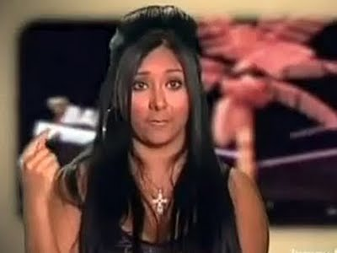

Slide 22
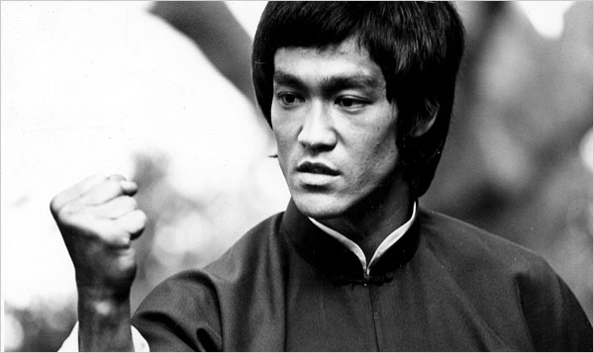

Slide 23
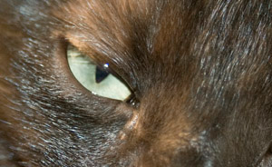
Extreme Close Up
Focus in on some particular detail
Usually more detail than a normal human eye could see in a usual situation
On a person or subject it usually starts at bottom of chin up to halfway of forehead
Could be closer than this too

Slide 24
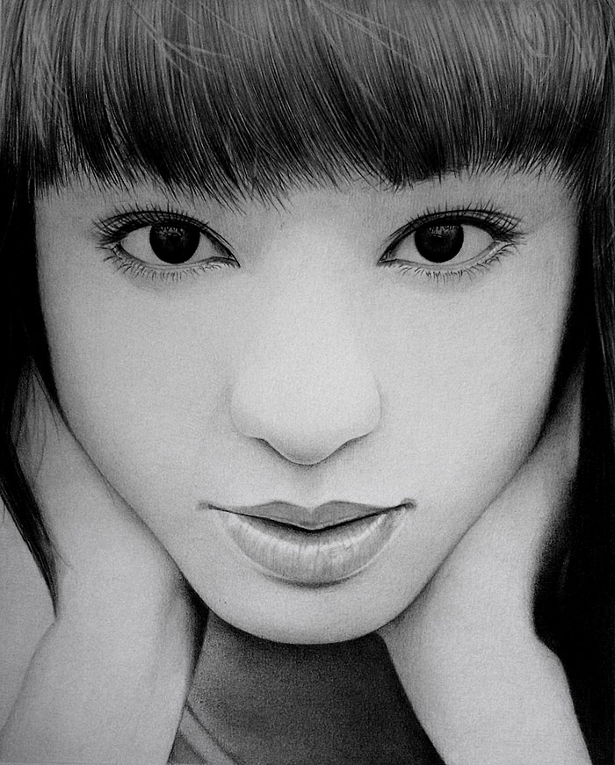

Slide 25
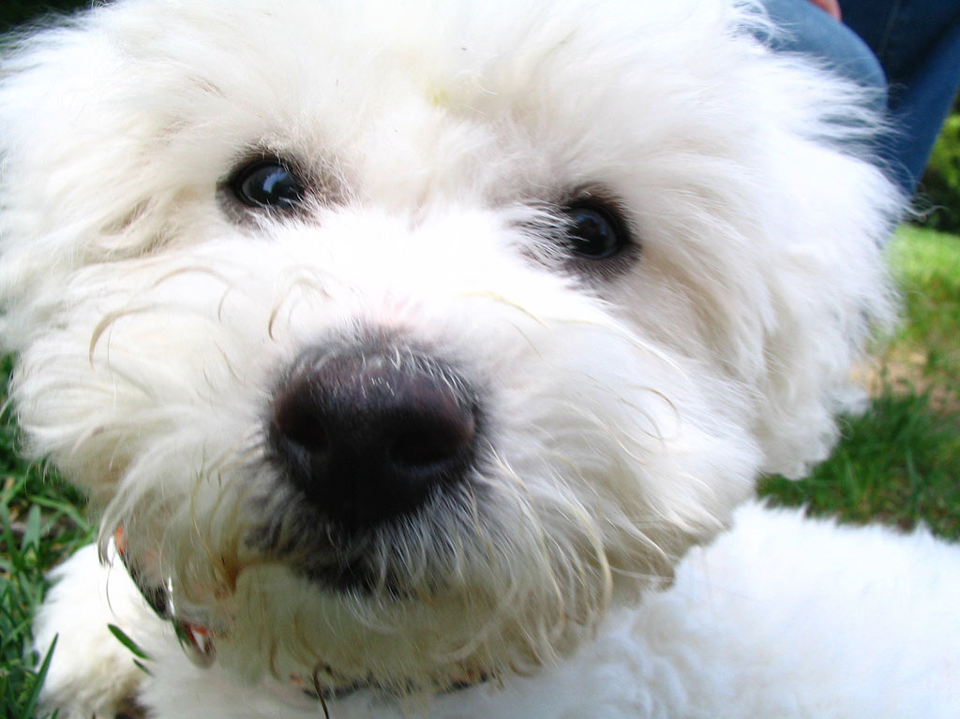

Slide 27
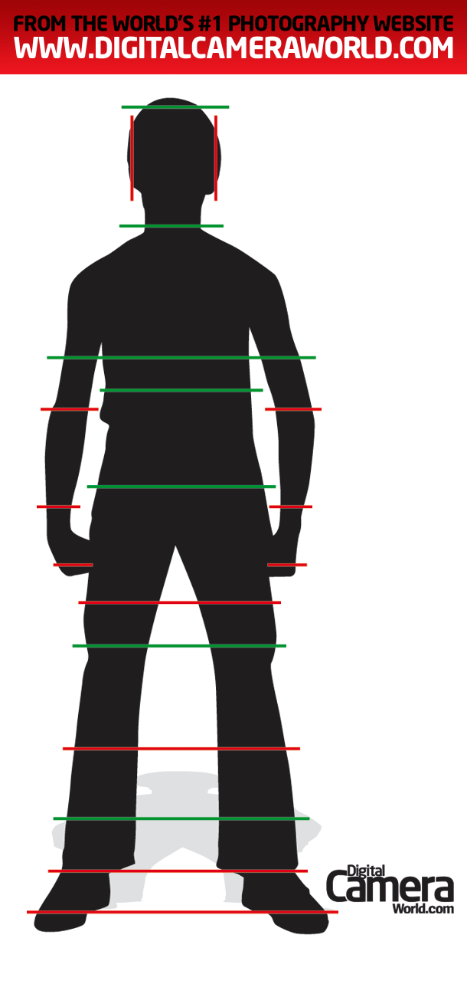
Porter
Portrait Photography Cropping Guide.

Slide 28
What you need to do
Use this information to improve your photography.
Pay attention to the type of shot you are taking and ask yourself if the subject would look better, using the rule of thirds.

