Slide 1
Mr. Chau’s 28th Lesson

Slide 2
Vocabulary
1) Wilfrid Laurier—first French-Canadian Prime Minister to be elected into Canada’s government..
2) Imperialism—extending control of a region to other nations
3) Boer War– South African War caused by Britain wanting to take over the region to exploit their diamonds and gold.
4) Dreadnought—the first all big gun battleship that is considered the largest sized ship.

Slide 3
Vocabulary
5) Naval Service Act—an act created by Wilfrid Laurier that states Canada will lend Britain their navy in times of emergency.
6) Reciprocity—an exchange or sharing.
7) Tariff—a tax put on goods leaving a country to protect a nation’s economy.

Slide 4
Canada is a Nation that stretches from Coast to Coast
Obstacles:
Economic power: Canada struggles to compete with their neighbour—the United States which pose a threat to their nation in the early years of Confederation.
Politic issues: Canada wants to become independent of Britain completely. Although they had power to run their own country, Britain still had some form of power over Canada’s nation as a whole. Also, Canada has created tensions between multiple groups of people while forming a country: (First Nations, Metis, Chinese, Irish, French, etc.)

Slide 5
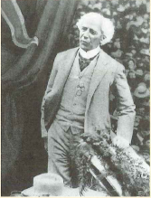
Sir Wilfrid Laurier was elected as Prime Minister: 1896
Canada’s First French-Canadian Prime Minister.
French and English ties were weak because of the Northwest Uprising incident and the execution of Louis Riel.
Laurier’s goal was to promote national unity.
Laurier won his election because of a crisis that happened over the Manitoba school system.
1) Manitoba created an English only school system.
2) This event violated the Manitoba Act.
3) John A. Macdonald’s government didn’t want to do anything.
4) Laurier did want to solve the issue. People voted for him.

Slide 6
Imperialism
First task for Laurier: Uniting the French and the
English: harder to do than just by saying.
Solution: Canada needs to be more independent.
English Canadians favoured the “mother country”
Britain---a country that expresses imperialism --extending control of a region by creating colonies
Problems:
Canada was using the British navy which were stationed in Esquimalt, BC and Halifax, Nova Scotia.
Turning Points: An event or something that changes a decision and its consequences after.
1) South African War/Boer War 2) the Naval Crisis

Slide 7
South African War/Boer War
Britain’s Imperialism causes the nation to try to control South Africa.
Boers—descendents of early Dutch colonists---resisted violently.
Britain wanted South Africa’s newly discovered gold and diamond mines.
Boers declared war on Britain in 1899.
Britain wants Canada (still connected to Britain at the time) to send troops to support the war.
DECISION TIME FOR LAURIER!

Slide 8
English-Canadians Supported the British side because they believe their mother country is at risk in losing its power. | French-Canadians Supported the Boers. They believe Britain is unjust for trying to take South Africa’s newly discovered resources.
LAURIER’S DECISION:
Tried to satisfy both sides: He sent “volunteer” troops to help fight the war so
That it wasn’t mandatory to fight.
BUT: as the war dragged on, Canada continued to send volunteer troops over
and spent $3million with 7300 volunteer troops total on a war that wasn’t even
supposed to be Canada’s business.
Angered the French citizens.

Slide 9
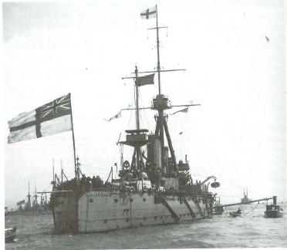
The Naval Crisis
Germany’s navy began to expand and challenge Britain’s domination of the sea.
Britain responds by building the HMS Dreadnought—that started the naval race in the world.
English Canadians wanted the government to spend money to contribute to Britain’s navy. French Canadians wanted Canada to build their own fleet.
Laurier creates the Naval Services Act: Canada would have their own navy but will be lent to the British in times of need. Britain responds by giving them two cruisers: Niobe and the Rainbow.
By the start of WWI, Canadians still did not have a naval policy and were stuck with two obsolete, British warships. Laurier was opposed!

