Slide 1
Mr. Chau’s 29th Lesson

Slide 2
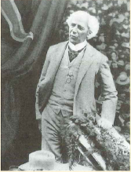
Sir Wilfrid Laurier was elected as Prime Minister: 1896
Canada’s First French-Canadian Prime Minister.
French and English ties were weak because of the Northwest Uprising incident and the execution of Louis Riel.
Laurier’s goal was to promote national unity.
Laurier won his election because of a crisis that happened over the Manitoba school system.
1) Manitoba created an English only school system.
2) This event violated the Manitoba Act.
3) John A. Macdonald’s government didn’t want to do anything.
4) Laurier did want to solve the issue. People voted for him.

Slide 3
Reciprocity
Issue with a free trade problem in Canada:
The English farmers want to buy cheap farming equipment from the United States.
Asked Laurier to negotiate reciprocity (sharing) with the U.S. so they can buy cheap equipment without paying tariffs and taxes at the border.
Laurier’s government agreed.
Canadian business owners outraged because of the negative effects it had on the Canadian economy.

Slide 4
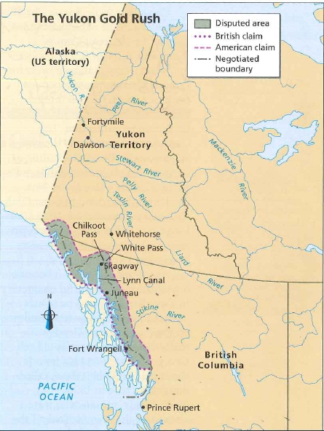

Slide 5
Alaskan Boundary Dispute
U.S. Bought Russia’s Territory in Alaska.
Canada negotiated the boundary to the 54° 40’ line.
Since U.S. bought the land—it’s a different story. Canada wanted the section all the way to the coastline.
Negotiated with an international tribunal: 3 U.S. Judges, 2 Canadian Judges, 1 British Judge.
The British judge sided with the Americans. Canada was outraged.
Pushed for independence more.

