Slide 1
The Railway Survey
Macdonald had no idea how much a railroad would cost when he promised BC.
Scandal caused Mackenzie to come to power.
All Mackenzie did was survey for the railroad—not build it.
Sanford Fleming was the Chief Surveyor of Canada.
Two main civilizations in BC: Vancouver Island and New Westminster.

Slide 2
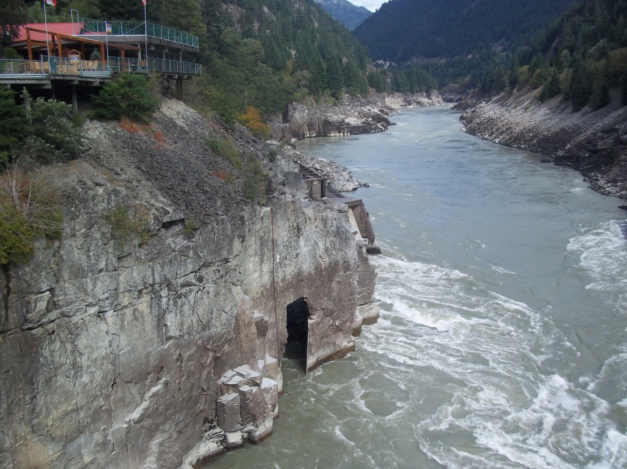
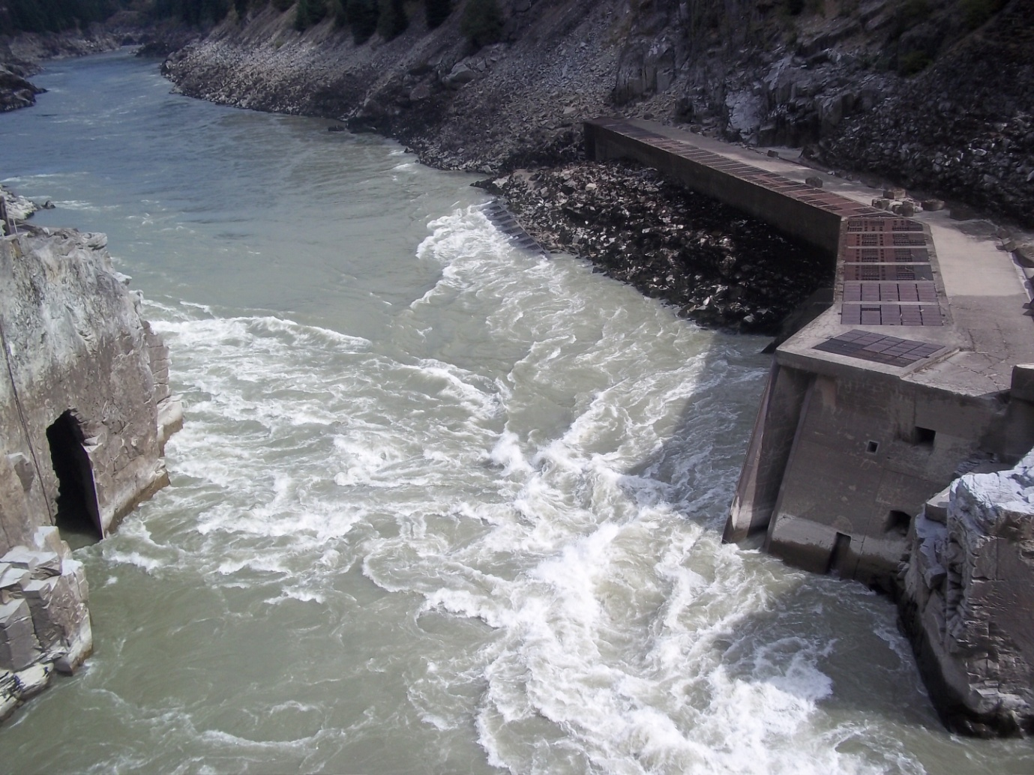
The Railway Survey
Building a railroad across the Rocky Mountains is difficult enough. But after you pass the Rockies, you still have to deal with tough locations such as areas along the Fraser Canyon.

Slide 3
The Railway Survey
Political debates sparked between the two main civilizations on Vancouver Island vs. New Westminster.
Vancouver Islanders wanted the route to be more North because that is where the closest distance between Vancouver Island and the mainland BC is.
Mainlanders wanted the CPR route to go down the Fraser Canyon to the Burrard Inlet.
Eventually the mainlanders won.

Slide 4
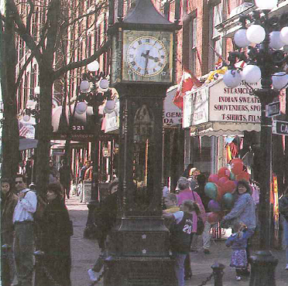
The Emergence of Vancouver
Mainlanders were expecting the route of the CPR to be built down to New Westminster or an area near there.
The initial proposed location was Port Moody.
William Van Horne arrived and found the area contained tidal flats= deep sea vessels cannot dock there.
Rerouted location to Vancouver’s waterfront next to Gastown.

Slide 5
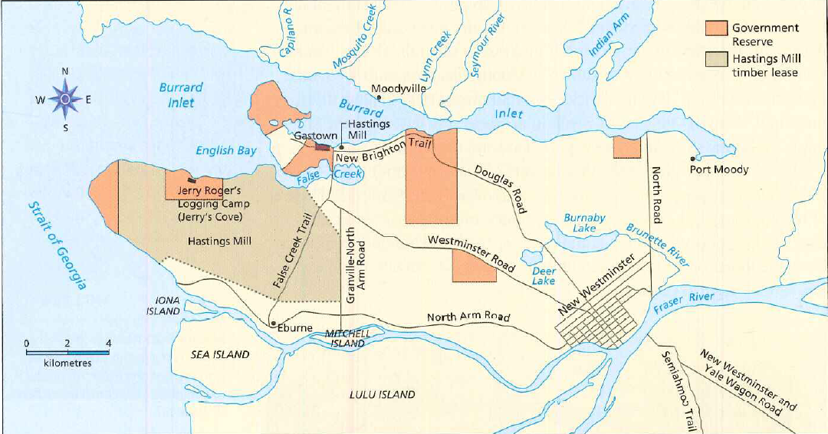

Slide 6
The Oppenheimers
Not only did BC had Chinese immigrants, they had others such as a Jewish community as well.
Oppenheimer family opened a business selling goods in Barkerville. Barkerville burned down and they lost $100,000 in goods.
When the gold rush was ending the Oppenheimers were looking for a new potential in business.
Invested highly in Vancouver property because they strongly believed the CPR will be the terminus station.
Convinced Van Horne to choose Vancouver as the CPR terminus location by giving up a part of their property.
David Oppenheimer became known as the “Father of Vancouver” and the first mayor.

