Slide 1
Mr. Chau’s 23rd Lesson

Slide 2
The Cariboo Gold Rush
1857-58 Gold was found along the banks of the Fraser and Thompson Rivers.
People were extremely gold conscious because of the recent California Gold Rush.
Caused a boom and bust situation at Barkerville when Billy Barker struck gold!
Boom and Bust= a civilization that base their source of income on one single resource—in this case gold.
Attracted a lot of Americans which causes a potential threat to the area.

Slide 3
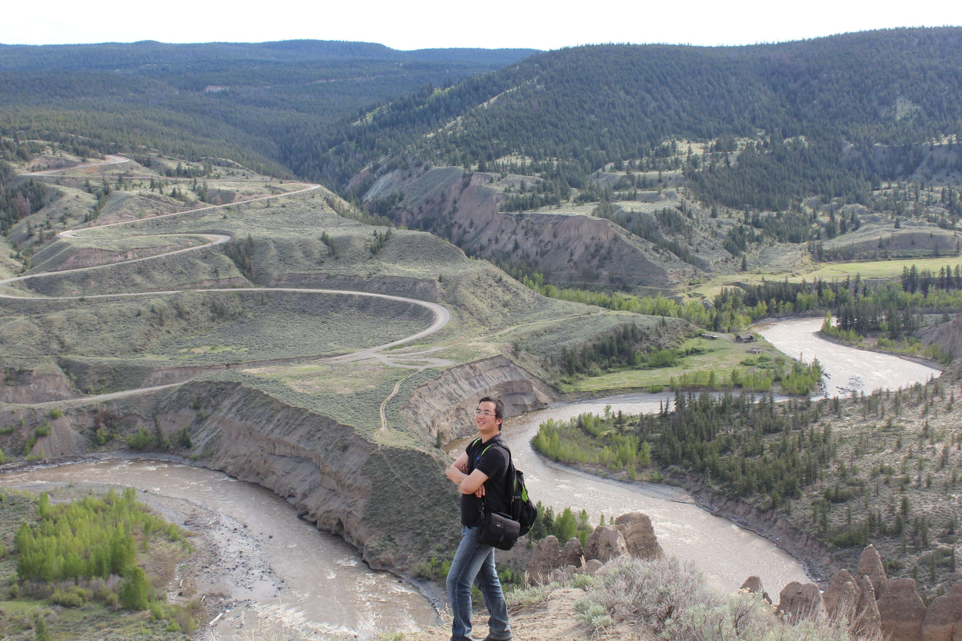

Slide 4
Cariboo Wagon Road
Governor Douglas poured a lot of money into creating a wagon road for the mining operations that’s been happening. He though that if he built a road that lead to the gold fields, he could ensure gold would leave the region via the Fraser so that he could tax the miners before they left back to the U.S.
Problem: Extremely expensive—over $750,000 to make in 4 years.
Gold rush coming to an end after it was done.

Slide 5
Tragedy for First Nations Peoples
--No Cariboo Wagon Road until the end of the Gold Rush.
Miners relied on First Nations people who knew the geography of the area to take them along personal trails to get to the gold fields.
Smallpox—a disease that came from Europeans had an outbreak in 1862 during the gold rush. The First Nations people who have never been exposed to diseases like this have a small chance of surviving once they were infected.
Biggest devastating effect was on the Haida First Nations people located on Haida Gwaii. Over 80% of the population died.

Slide 6
Vocabulary
Fraser and Thompson Rivers: the rivers where the Cariboo gold rush took place.
Barkerville—a boom and bust town named after Bill Barker when he discovered gold in the area.
Richard Moody– Colonel of the Royal Engineers who policed the area of the gold rush to make sure the British presence stayed strong in the midst of American gold miners.
Cariboo Road—a project created by Governor Douglas to ensure gold mined from BC is taxed before it leaves the area.

Slide 7
Vocabulary
Frederick Seymour—governor who replaced James Douglas in BC colony
Arthur Kennedy—governor who replaced James Douglas on Vancouver Island colony.
Smallpox—a devastating disease brought over by the European settlers to Canada that killed off a large population of First Nations peoples.
Haida—a first nations band from Haida Gwaii who suffered the most amount of population loss from the smallpox disease.

Slide 8
Vocabulary
Responsible Government—a form of government where elected members are held responsible by their people for their actions.
Anthony Musgrave—John A. Macdonald’s friend who became the new governor of British Columbia. He pushed for Confederation and succeeded.

