Slide 1
Socials 10 HT
Canadian Regions

Slide 2
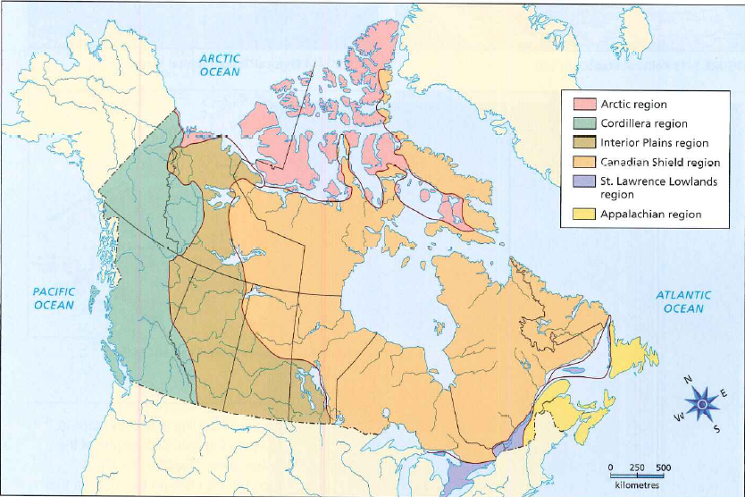
Physical Regions

Slide 3
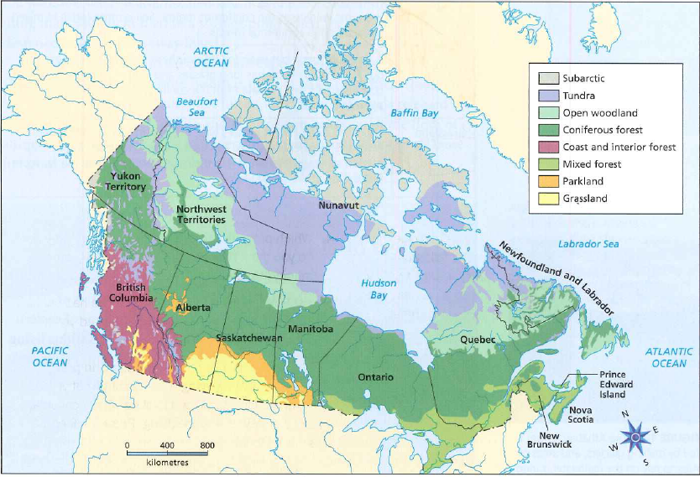
Natural Regions

Slide 4
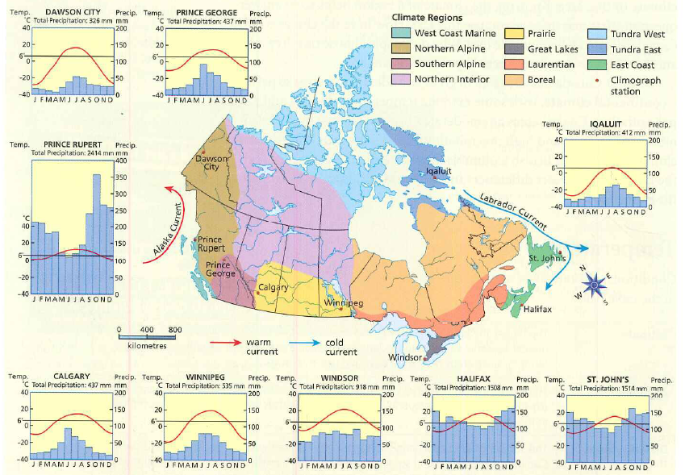
Climate Regions

