Slide 1
Lesson 3: Why Government Needs to Reform

Slide 2
Reform
Two parts to the word: RE and FORM
- basically means to remake the government because there is a problem with the current structure of it.

Slide 3
Representative Government
- A government where people elect members to make decisions for them.

Slide 4
Responsible Government
A system where the elected members who are making decisions are not satisfying the others they will be voted off.

Slide 5
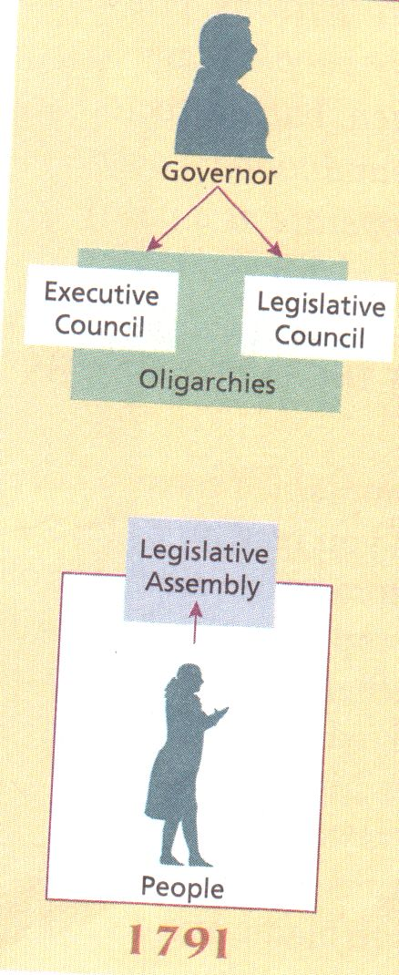
What was wrong with Upper Canada’s government?/Why the need to reform?
Owned by rich people called the Family Compact
Britain appoints a governor but they usually listen to the Executive committee that includes the Family Compact
Elected system is not really elected because the executive powers –including the governor has the right to VETO bills made by the legislative assembly.
“Seems like” democracy but not really.

Slide 6
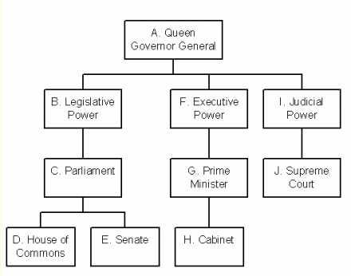

Slide 7
LOWER CANADA

Slide 8
Issues:
Similar governing body as The Family Compact: called Le Chateau Clique
Faces French discrimination and inequalities more but has less issues with land distribution problems.

Slide 9
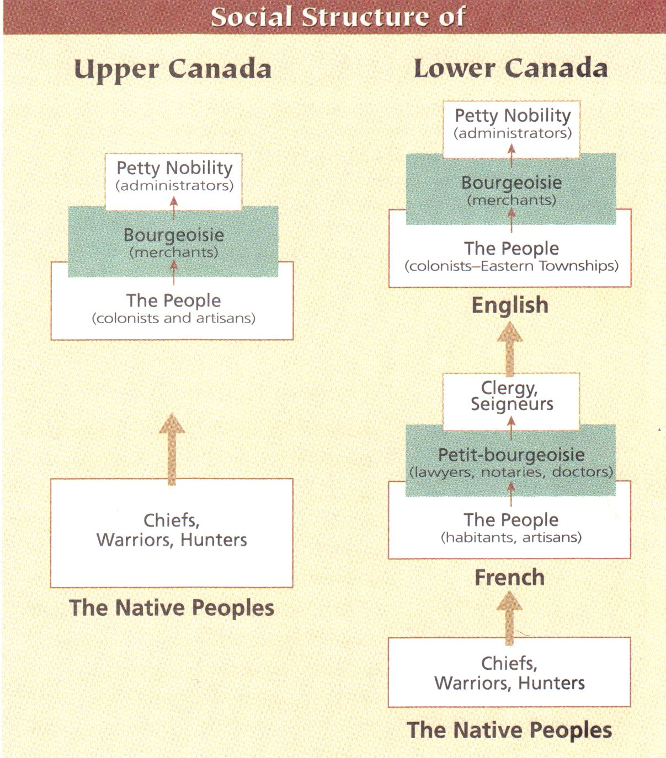
Seigneurial System
An old system where seigneurs/lords were granted parcels of land by France

Slide 10
British Government: Chateau Clique
French farmers hated the fact that the government was raising taxes against them but not other businesses
3 Reasons For Reform:
Discrimination against the French
Unequal Taxation, and
Lack of Power in the Government.
Fact: There were more French than English in Lower Canada. 420,000 French to only 80,000 English. But the French people in the government “sold themselves out” to the English ways of leading the nation.

Slide 11
Essay Writing Workshop

Slide 12
Introduction
1) Start with an interesting point/fact that’s related to what you are going to talk about.
E.g. Essay Question: Why is jam better than peanut butter?
Your starting sentence might be:
Many people cannot eat peanut butter because they are allergic to peanuts.

Slide 13
Introduction
2) Give some background information that is necessary for readers to understand your essay better later.
E.g. Many people cannot eat peanut butter because they are allergic to peanuts. However, the famous peanut butter and jelly sandwiches did not become popular with just peanut butter as its ingredient.

Slide 14
What is the difference between a topic sentence and a thesis statement?

Slide 15
Difference Between a Thesis Statement and a Topic Sentence.
A Thesis Statement is a sentence or two that describes what your entire essay is going to be about.
A topic sentence is the starting sentence of the paragraph that tells us what the paragraph is going to be able.
E.g. Jam, the other ingredient needed to make a good P&J Sandwich, is the reigning champion over peanut butter. Jams come in different flavours because it can be made of different kinds of fruit.

Slide 16
Introduction:Thesis Statement
Wrap up your introduction with a good thesis statement.
Remember: the idea of each sentence is to attract a reader to continue reading your essay.
E.g. Many people cannot eat peanut butter because they are allergic to peanuts. However, the famous peanut butter and jelly sandwiches did not become popular with just peanut butter as its ingredient. Jam, the other ingredient needed to make a good P&J Sandwich, is the reigning champion over peanut butter.

