Slide 1
HUMAN RIGHTS

Slide 2
What are Human Rights?
“Rights to which all humans are entitled [to]”
“based on morality” what we perceive to be right or wrong.
“Not necessarily legally sanctioned (protected by law) in all countries”

Slide 3
Who made a Set of Standards?
The United Nations.
“An international organization that promotes peace and social well being throughout the world.”
Currently 193 member states.
Set of standards called “The Universal Declaration of Human Rights.”

Slide 4
Important Excerpts from the Declaration
I) All human beings are born free and equal in dignity and rights.
II) Everyone is entitled to all rights set forth in this Declaration, without prejudice of any kind, such as discrimination based on race, colour, sex, language, religion, political or other opinion, national or social origin, property, birth or other status.
III) Everyone has the right to life, liberty, and security of person.
IV) No one shall be held slavery or servitude.
V) No one shall be subjected to torture or to cruel, inhuman or degrading treatment or punishment.
VI) All are equal before the law and are entitled without any discrimination to equal protection of the law.
VII) No one shall be subjected to arbitrary arrest, detention or exile.
VIII) Everyone has the right to an education.
IX) Everyone has the right to freedom of movement.
X) Everyone has the right to freedom of thought, conscience and religion.
XI) Everyone has the right to freedom of opinion and expression.
XII) Everyone has the right to a standard of living adequate for health and well being.

Slide 5
Leticia Sarmiento Case Study
http://www.cbc.ca/player/Embedded-Only/News/BC/ID/2388743622/

Slide 6
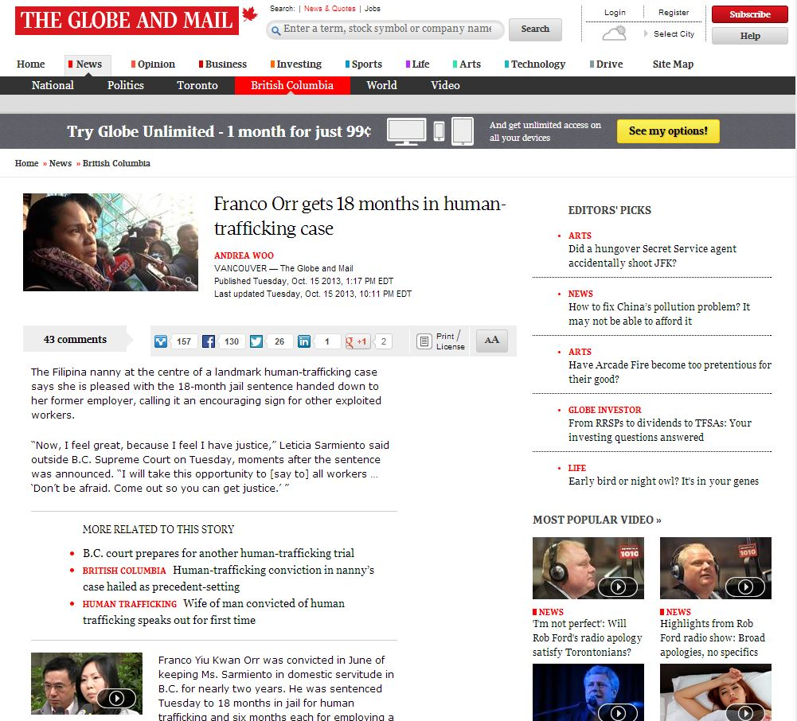

Slide 7
In his reasons for the sentence, Justice Richard Goepel noted Mr. Orr was a productive member of society with no past criminal record. As well, the Crown had failed to prove beyond a reasonable doubt a number of aggravating factors – including that Ms. Sarmiento was allegedly made to work 16 hours a day, every day, in “humiliating and degrading” conditions – which puts the offence at the lower end of the continuum, he said.
As an example, Justice Goepel noted Ms. Sarmiento claimed the family kept her passport from her, but a Vancouver bank employee testified that she had presented it when trying to open an account. As well, she said she was permitted to phone home to the Philippines only once a month, while phone records showed about 100 calls to a cellphone number in the Philippines during the time she lived with the family.
“The fact that Mr. Orr was convicted does not mean that the jury believed all of Ms. Sarmiento’s evidence,” he said Tuesday. “The jury was free to accept some, or all, of her evidence. The jury’s decision to acquit Ms. Huen of the charges against her was a clear indication the jury did not accept all of Ms. Sarmiento’s evidence.”
Nonetheless, Ms. Sarmiento was undoubtedly a victim.

Slide 8
Important Excerpts from the Declaration
I) All human beings are born free and equal in dignity and rights.
II) Everyone is entitled to all rights set forth in this Declaration, without prejudice of any kind, such as discrimination based on race, colour, sex, language, religion, political or other opinion, national or social origin, property, birth or other status.
III) Everyone has the right to life, liberty, and security of person.
IV) No one shall be held slavery or servitude.
V) No one shall be subjected to torture or to cruel, inhuman or degrading treatment or punishment.
VI) All are equal before the law and are entitled without any discrimination to equal protection of the law.
VII) No one shall be subjected to arbitrary arrest, detention or exile.
VIII) Everyone has the right to an education.
IX) Everyone has the right to freedom of movement.
X) Everyone has the right to freedom of thought, conscience and religion.
XI) Everyone has the right to freedom of opinion and expression.
XII) Everyone has the right to a standard of living adequate for health and well being.

Slide 9
Important Excerpts from the Declaration
I) All human beings are born free and equal in dignity and rights.
II) Everyone is entitled to all rights set forth in this Declaration, without prejudice of any kind, such as discrimination based on race, colour, sex, language, religion, political or other opinion, national or social origin, property, birth or other status.
III) Everyone has the right to life, liberty, and security of person.
IV) No one shall be held slavery or servitude.
V) No one shall be subjected to torture or to cruel, inhuman or degrading treatment or punishment.
VI) All are equal before the law and are entitled without any discrimination to equal protection of the law.
VII) No one shall be subjected to arbitrary arrest, detention or exile.
VIII) Everyone has the right to an education.
IX) Everyone has the right to freedom of movement.
X) Everyone has the right to freedom of thought, conscience and religion.
XI) Everyone has the right to freedom of opinion and expression.
XII) Everyone has the right to a standard of living adequate for health and well being.

