Slide 1
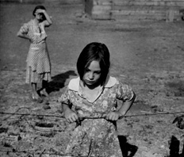
Introduction to Photography
Child and her Mother - Dorthea Lange
‹#›
Notes:
‹#›

Slide 2
Photography is Art created by Light!
‹#›

Slide 3
What is Photography?
Photography is an art form like drawing and painting. Photographers use their camera to make us see life in a different way, feel emotions, and record stories and events.
‹#›

Slide 4
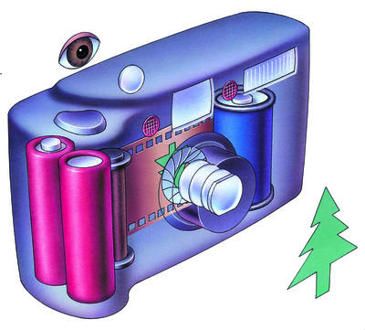

How a Camera works…
Notice the inverted
(upside-down) tree.
When the shutter of a camera is opened, light passes through the lens
and onto the film. The film is covered with chemicals that create a
pattern of light on the film. This becomes the negative.
‹#›

Slide 5
There are three basic styles of photography.
Landscape
Portrait
Documentary
‹#›

Slide 6
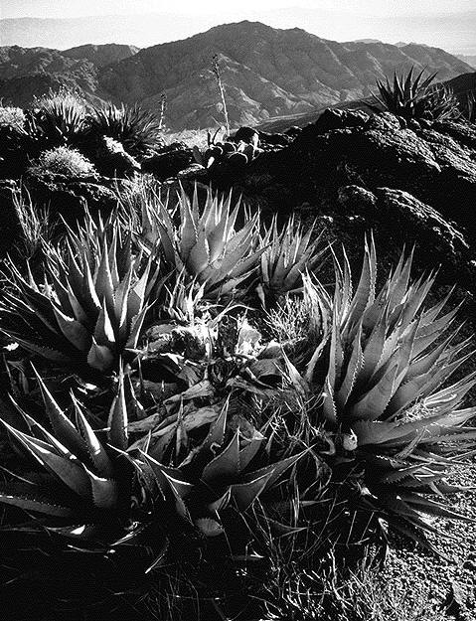
Landscape
Landscape is a photograph of the environment. It could be the forest, mountains, oceans, or your backyard. Ansel Adams is a famous landscape photographer. Here is one of his images.
‹#›

Slide 7
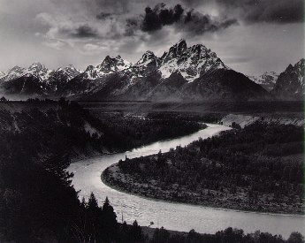
Here is another of Ansel Adams Photographs
‹#›

Slide 8
What is Landscape Photography?
Landscape photography is a
photograph of the outdoors.
It could be of the land,
water, or buildings.
‹#›

Slide 9
What do you see in your landscape photograph?
‹#›

Slide 10
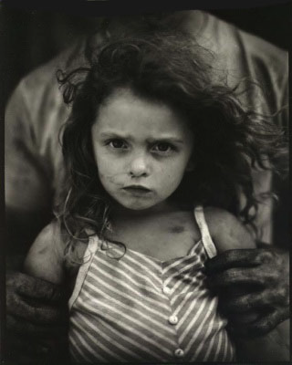
Portrait Photography
Portrait photography is a photo of a person or animal.
It is important to show an emotion.
What is the emotion shown in this photo?
Scared
Angry
Other…
Holding Virgina - Sally Mann
‹#›

Slide 11
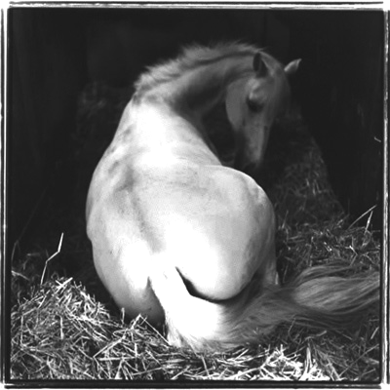
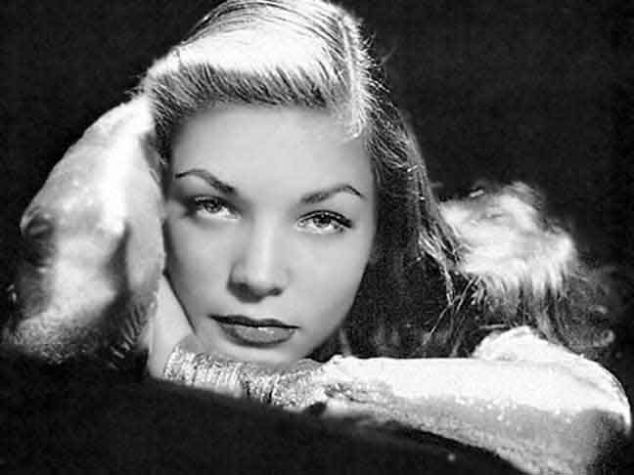
Different Portrait Styles
Lukasz Holma, Poland - Lauren Bacall
Rubenesque - Keith Carter
Can you compare and contrast these photographs?
How are they similar? How are they different?
‹#›

Slide 12
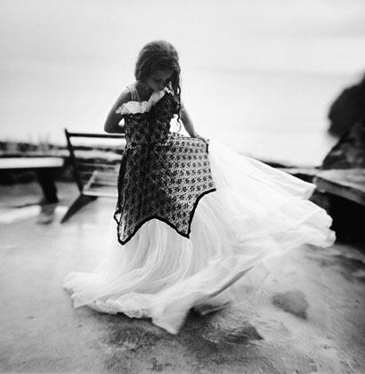
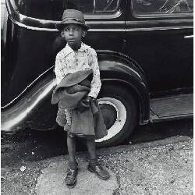
More Portraits
Portraits can be the whole body.
The Dress - Sally Mann
Boy and Car, New York City - Jerome Liebling, 1949
‹#›

Slide 13
What is Portrait Photography?
A portrait photograph is a picture of a person or animal that shows an emotional connection.
‹#›

Slide 14
What are some ways you can make a portrait photograph creative and different from everyone else?
‹#›

Slide 15
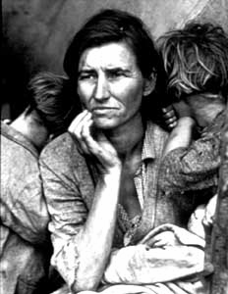
Documentary
Documentary photography presents facts without changing anything.
Good documentary photographs make you wonder what the story is behind the photograph.
Migrant Mother - Dorthea Lange
‹#›

Slide 16
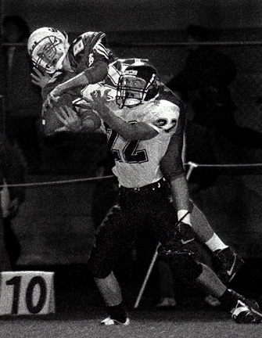
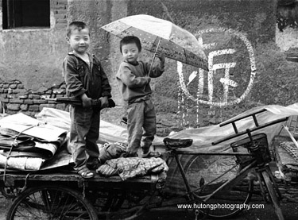
What are the stories in these photos?
‹#›

Slide 17
Where do you find documentary photographs?
Magazines
Newspaper
Books
Internet
‹#›

Slide 18
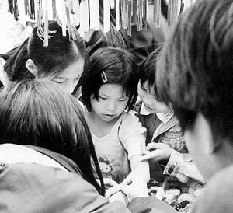
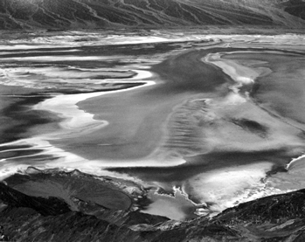
Documentary photographs can be either landscape or portrait.
Dante’s View - 1938 Edward Weston
Portrait
Landscape
Which photo shows a portrait, and which shows a landscape?
‹#›

Slide 19
What is Documentary Photography?
Documentary Photography tells a story without changing
the facts.
It can be a portrait or landscape.
Remember that a good documentary photograph makes you
wonder what the story is behind the picture!
‹#›

Slide 20
What stories can you tell with your camera?
‹#›

Slide 21
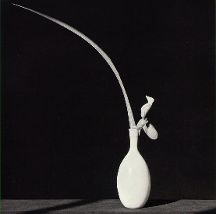
Contrast
Contrast refers to the brightness between the light and shadow areas of a picture.
Does this photograph have contrast?
Mapplethorpe, Orchid and Leaf in White Vase 1982
‹#›

Slide 22
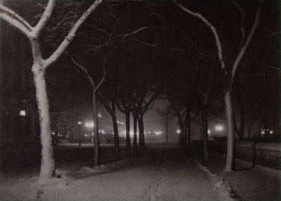
Does it have contrast? What direction is the light on the trees coming from?
Alfred Stieglitz - Icy Night, 1893
‹#›

Slide 23
What is Contrast?
Contrast is the difference between light and shadow.
Think about a flashlight in a dark room.
Don’t think about zebras or pianos!
LIGHTS
SHADOWS
‹#›

Slide 24
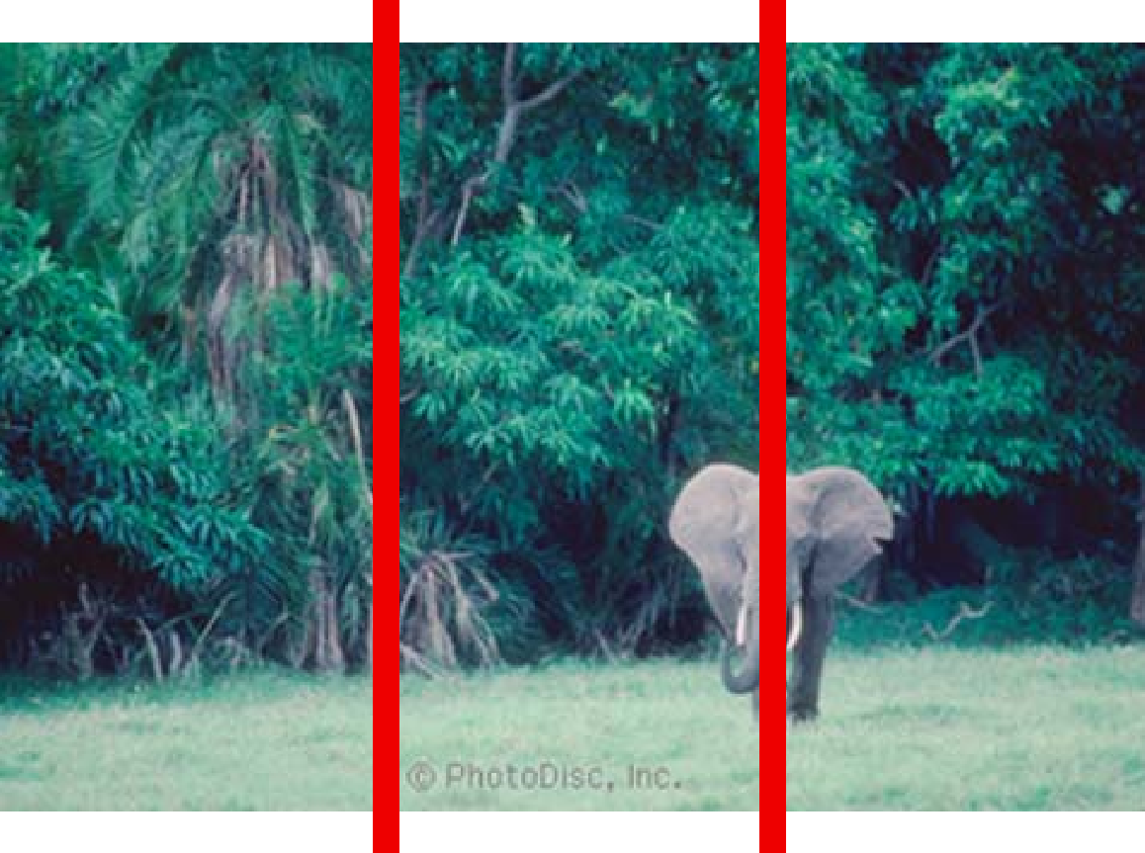
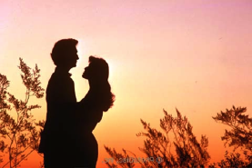
Rule of Thirds
A photo is more interesting if the subject is NOT directly in the center. Try placing your subject 1/3 to the left or right, or 1/3 from top or bottom.
‹#›

Slide 25
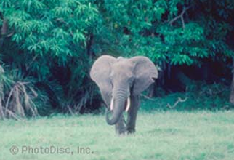
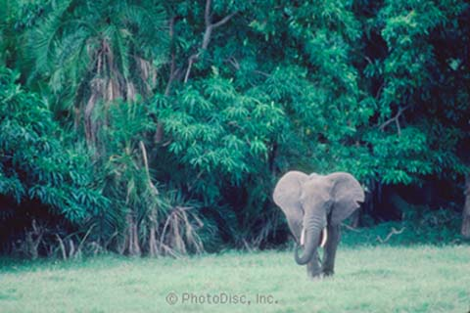
One photograph uses rule of thirds and the other uses central focus.
Central Focus
Rule of Thirds
Which photograph do you find more interesting?
WHY?
‹#›

Slide 26
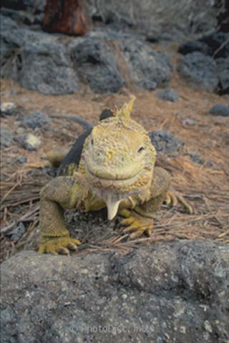
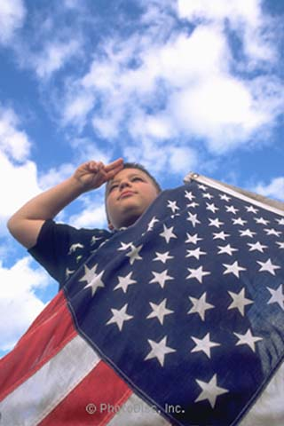
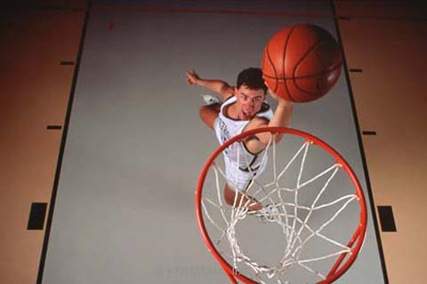
Point of View
Try selecting and unusual point of view.
Above
Eye Level
Below
Where was the photographer standing for each picture?
‹#›

Slide 27
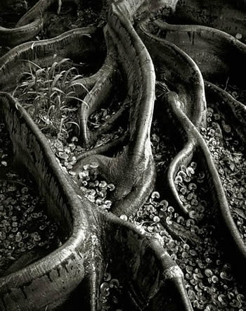
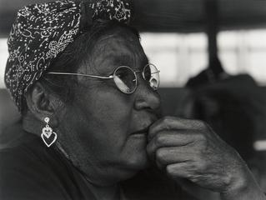
Proximity
Don’t be shy! Get close to your subject.
‹#›

Slide 28
are tools to help you MASTER the art of photography.
Contrast,
Rule of Thirds,
Point of View,
and Proximity
‹#›

Slide 29
“One should really use the camera as though tomorrow you'd be stricken blind.”
-Dorthea Lange
‹#›

