Slide 1
Mr. Chau’s 10th Lesson

Slide 2
Tip of the Day:
When writing a test, unless it tells you to go in order, complete the challenging questions first. (e.g. Paragraph questions before multiple choice)

Slide 3
Recap on the Reformation Video

Slide 4
King Henry VIII
Wants to separate from his wife.
Wants to produce a male child to succeed his throne.
Figured out a way: Act of Supremacy. He makes the Church of England under direct command of King instead of the Pope.
A new religion is created: Anglican. (Related to Protestant)

Slide 5
King Edward VI
Was the son of King Henry VIII
Died when he was fifteen years old.
Protestantism is fully established under his rule.
He became sick and found out it was unrecoverable.
He named his cousin Lady Jane Grey to be the next heir to the throne.

Slide 6
Mary I of England (also known as Bloody Mary)
Assembled a force to physically remove Lady Jane Grey off the throne and beheaded her.
Was the only surviving daughter of King Henry VIII’s initial wife Catherine of Aragon.
Changed England’s religion back to Roman Catholic. Anyone who wasn’t was burned at stake. (about 283 people)
Her half sister, Elizabeth I, also daughter of King Henry VII

Slide 7
Elizabeth I
Ruled by good counsel—trusted her Parliament well.
Famous as a virgin because she never married.
Switched back England into Protestant Religion.
Brought back English drama. Shakespeare.
Ruled for 44 years.

Slide 8
Catholic Vs. Protestant.
Catholic:
Loves decorations and elaborate.

Slide 9
HUMANISM
But believing in yourself more DOESN’T mean they’re believing in God less. Humanism does NOT reject religious ideas.
Because they’re not rejecting religion this is when great things can be built using the ideas of human beings. (Santa Maria del Fiore)
Renaissance is all about change. Changing the way how people think. Changing the way how things look.
This includes art! They care about the humans more so painters and artists started to paint more that show human faces. Beautiful faces. Ugly faces.

Slide 10
Today’s Guiding Question
What technologies are there that help promote the spread of Renaissance ideas once they started booming in Italy?

Slide 11
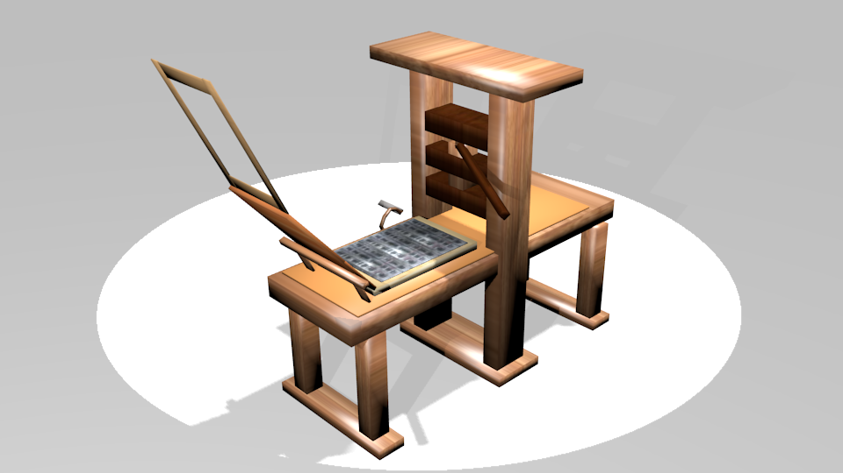
Printing Press

Slide 12
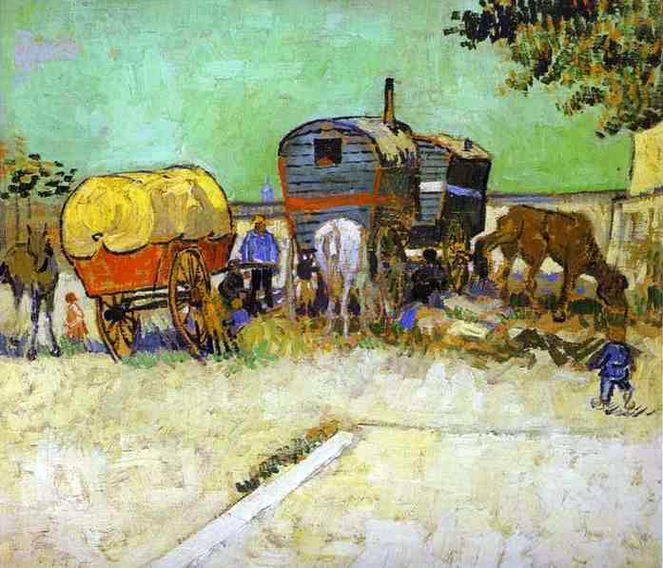
Caravans & Trade

Slide 13
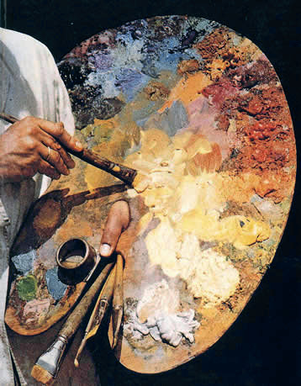
Oil Painting

Slide 14
Writers/Recorders
- you needed people to write and record these ideas to turn them into books for others to read.
- teamed up with the Printing press, the information gets bound into books and storage facilities (i.e. Libraries) started to emerge all over Europe as a means to store information.
- Traders would read and spread ideas around through the use of caravans. They will bring books and paintings using the oil paints to spread new perspectives of viewing the world and new ideas that come after.

Slide 15
Scientific Revolution
Remember what humanism is?
Reason helps expand knowledge about the natural world.
THINK, PAIR, SHARE.

Slide 17
The Reformation
http://www.history.com/topics/reformation/videos/protestand-reformation-english-reformation

