Slide 1
Mr. Chau’s 18th Lesson

Slide 2
Vocabulary
49th Parallel—The line of latitude that serves as a boundary between Canada and the United States.
Oregon Territory—an area along the west coast that is being sought after by Russia, Canada, and the United States.
Manifest Destiny– a belief that the United States will take over the entire continent of North America.
John McLoughlin—Initial Chief Factor of Fort Vancouver who established a friendly relationship with the Americans.

Slide 3
Vocabulary
The Beaver—a mobile steamship trading post belonging to the HBC that sailed in the Oregon region
James Polk—a democratic president candidate for the United States that tried to take over the Oregon Territory up to the 54° 40’ marker.
James Douglas—Governor of the Vancouver Island colony.

Slide 4
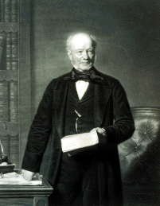
George Simpson= Governor of HBC—known as the little emperor
Russia claimed the BC coast as far south as Northern Vancouver Island.
49th Parallel drew a line only up to the edge of the Rocky Mountains—everything on the other side was considered the Oregon Territory
HBC saw it as an extension of Rupert’s Land so it’s fighting for it too.
American’s encouraged settlement in this area in order to close in on their goal of controlling the entire North America known as the Manifest Destiny
HBC had no interest in encouraging settlement because it might disrupt fur trade or undermine the company’s trade monopoly.

Slide 5
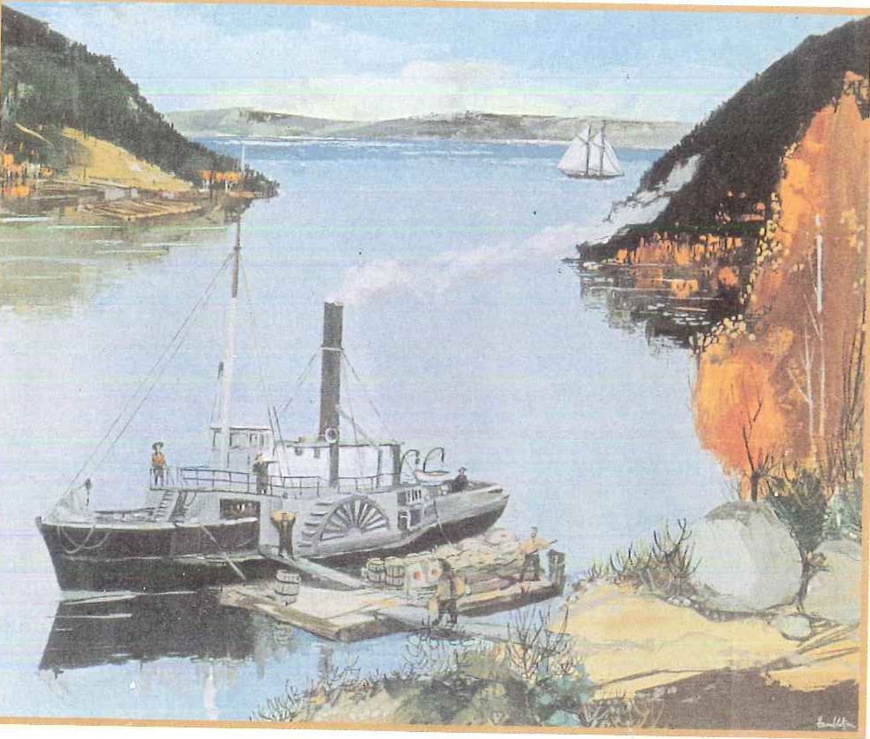
1826-27, In order to control the territory better, Simpson chose Chief Factor John McLoughlin to manage the area. McLoughlin is a capable administrator with an unnerving presence. He often forgets to bathe. He’s known for his fairness, and for rewarding employees with parties and banquets.
He understands politics really well so instead of fighting with the Americans, he told them to only settle south of the Columbia River and stay out of the North side.
He offered help to American immigrants
They created 2 major HBC posts: Fort Vancouver and Fort Langley to establish a presence in this region.
However, the HBC also had to compete with Russia. They made a deal with them to not go beyond 54 degrees and 40’ and in exchange for that the HBC steamship, The Beaver, will supply the Russian posts in Alaska with food.
This ship also establishes more of a British presence in the area because it was a mobile post.

Slide 6
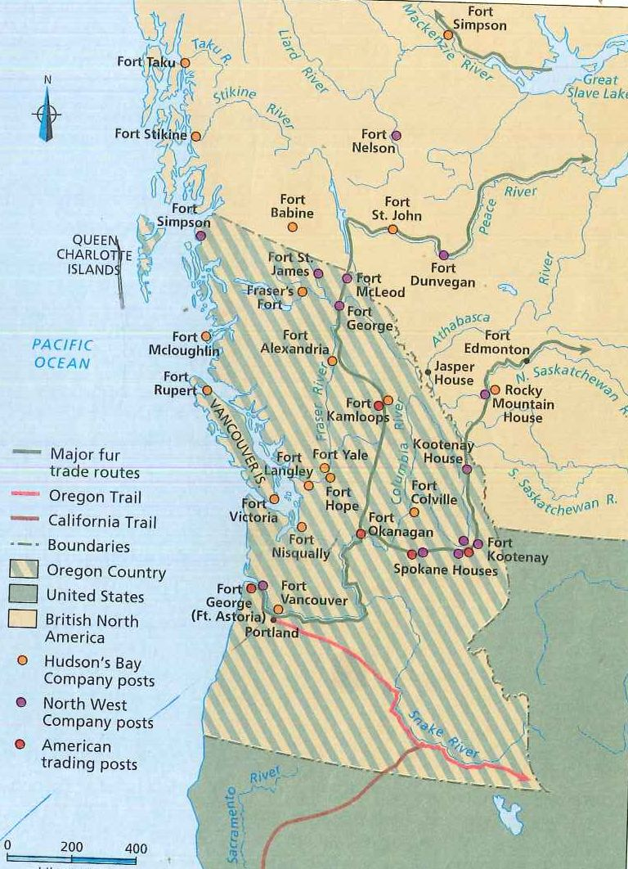
1841 Simpson came back to the region to discover that they were not expanding. Simpson ordered all coastal ports to be closed except for Fort Simpson and The Beaver. McLoughlin= furious because all his hard work for 15 years has gone to waste. Anger deepened when McLoughlin’s son was killed in a brawl at Fort Stikine and Simpson ruled it as a justifiable homicide. Encouraged more American settlement.
Simpson was alarmed and ordered James Douglas to establish a new depot on Vancouver Island. This became Fort Victoria in honour of Queen Victoria.
McLoughlin retired 2 years later from HBC—got a decent pension in recognition for his years of service and was called the Father of Oregon---few Americans know that he was actually born in Quebec.

Slide 7
