Slide 1
Mr. Chau’s 31st Lesson

Slide 3
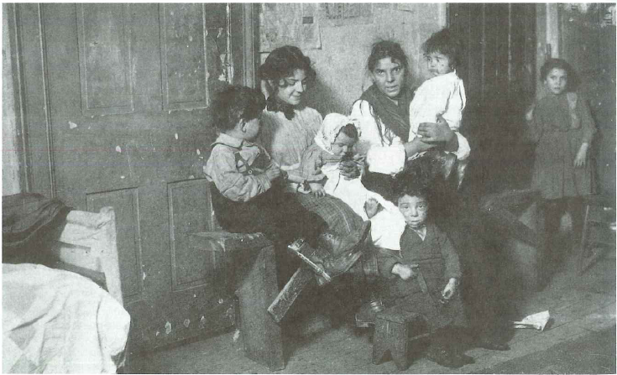

Slide 5
2 More Transcontinental Railways
Grand Trunk Railway
The Canadian Northern Railway
Subsidies for the building of the railways was $200million dollars
Bad Timing
WWI—decreased immigration.
Funding needed to be allocated towards war measures.

Slide 6
Prosperity Not Evenly Distributed
Big division between the rich and the poor
Working conditions were poor and wages were extremely low
Among the wealthiest was the Dunsmuir Family

Slide 7
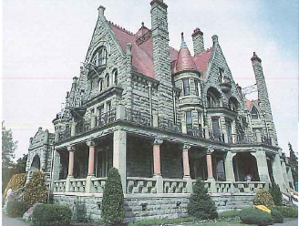
Dunsmuir Family
Ran a coal mine business
Robert Dunsmuir built Craigdarroch Castle
James Dunsmuir built Hatley Castle
Treated workers terribly with poor working conditions.
Pay was low.
Used a railway system to ship coal.

Slide 8
Labour Unions
10% of workers were in unions. Tensions rose between 1910-1914
Dunsmuir family undercut safety conditions: had a very strong and big unionized force as a consequence.
To solve problems, employers :
1) Hired strikebreakers (people who were willing to work for low wages and poor conditions).
2) Kicked workers out of their company owned houses.
Nanaimo= 179 arrests with 39 sentenced to jail.
Dunsmuir Family sold mines to Mackenzie and Mann—remained operational until 1930

