Slide 1
Mr. Chau’s 32nd Lesson

Slide 2
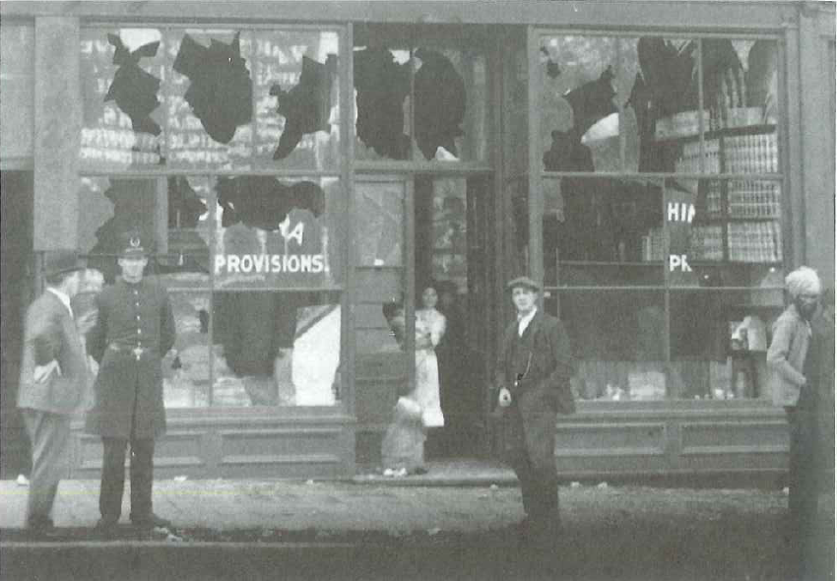
Closing the Door to Immigration
Frank Oliver= Replaced Clifford Sifton as the Minister of the Interior
Created a new policy that restricted Asian immigration: particularly those of (Chinese, Japanese, and East Indian descent)
Even though these immigrants tended to accept jobs that are low pay they still are extremely hardworking that caused business owners to hire them before anyone else.

Slide 3
Labour Organizations began fighting for a law to “exclude” these individuals because they are threatening the “white” citizens’ jobs.
Formed the Asiatic Exclusion League.

Slide 4
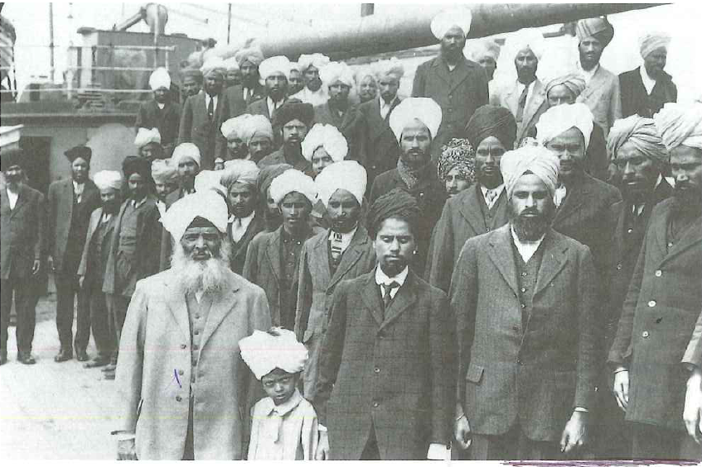
Immigration Act: Continuous Passage
East Indian people were British citizens as well
Canada created an amendment to its immigration act that only those that can come here through continuous passage may be permitted into the country.
Made a ship coming from India impossible to land because there is no way a ship can sail directly from there to Canada—the trip was too long.
Komogata Maru arrived in Vancouver, the passengers were not allowed to leave their ship.

