Slide 1
Mr. Chau’s 33rd Lesson

Slide 2
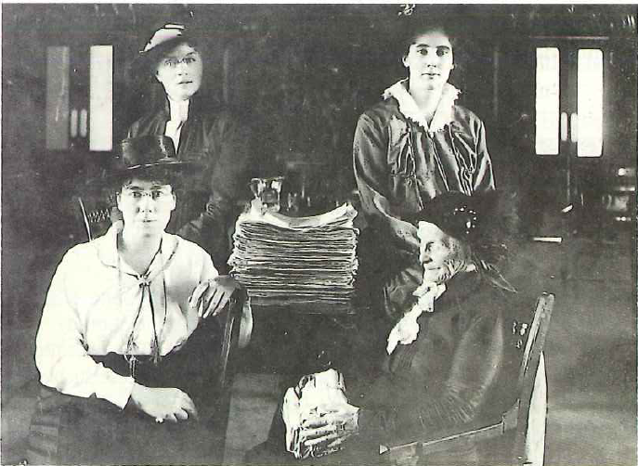
The Suffrage Movement
What drove women to fight for human rights:
Housework and tending to children made up most of a woman’s daily life.
Families had 10 to 12 children.
Women worked rarely outside of home.
Educational expectations were low.
Barred from many professions: such as law.
Not eligible for university scholarships.

Slide 3
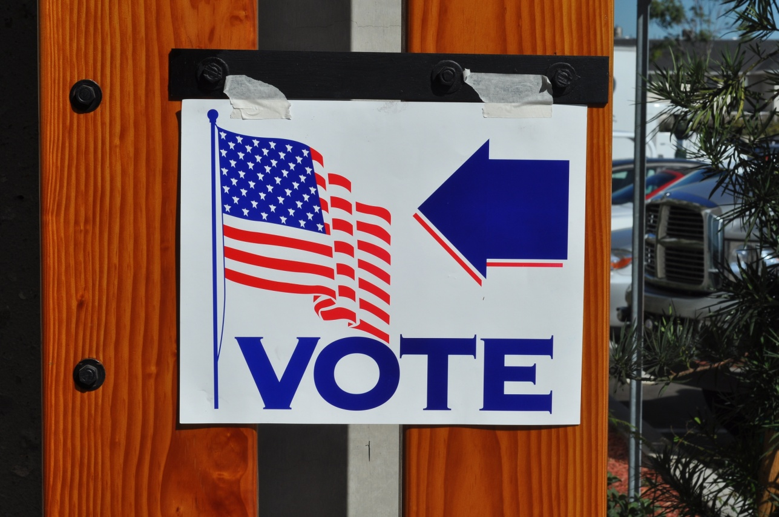
The Suffrage Movement
Why voting mattered:
Voting gives you the right to change the societal norms= standards of living for certain people
Suffrage= fighting for the right to vote
One of the things that women fought for was prohibition.
Active suffragist= Nellie McClung

Slide 4
The Suffrage Movement
Why it took so long for women to gain the rights to vote:
Belief of specific areas of life were particular to each sex
Politics and business= man’s job
Took over 45 years for women to gain the right to vote in BC
Took less in the prairies due to men’s understanding of harsh living conditions in the continental provinces. More inclined to think that men and women were equal.

Slide 5
The Suffrage Movement
Why voting mattered:
Voting gives you the right to change the societal norms= standards of living for certain people
Suffrage= fighting for the right to vote
One of the things that women fought for was prohibition.
Active suffragist= Nellie McClung

Slide 6
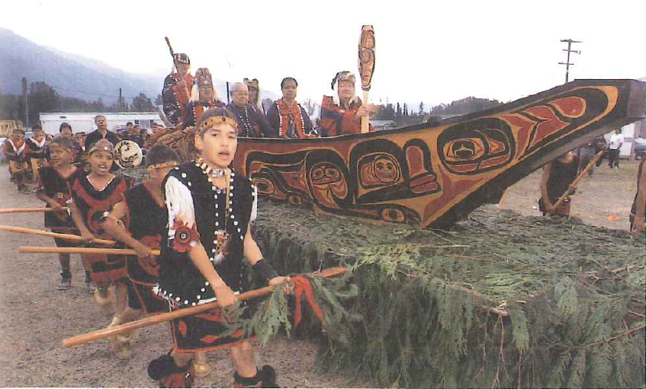
First Nations Rights
Canada’s federal government policy was to assimilate First Nations into Canadian culture.
Assimilation= Societal Norms. Not only in Canada but in other places around the world as well.
Assimilation= destroying one’s culture to establish or replace it with a different one.
In order to assimilate: Residential Schools that teach mainly of Christian faith.

Slide 7
Federal and Provincial Governments Can’t Agree to Land Issues
James Douglas signed Douglas treaties that recognized land claims.
Federal government wanted to establish reserves: land that was cordoned off for First Nations only—often poor quality land.
This is where First Nations started to fight for their rights:

Slide 8
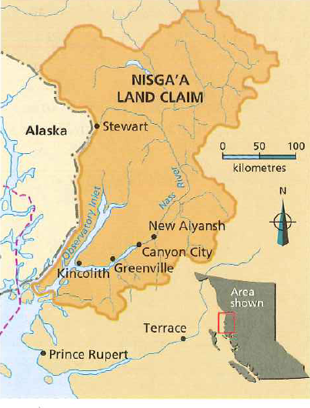
Nisga’a Land Treaty Claim
Signed on August 4th, 1998
Took over 90 years to resolve this issue.

Slide 9
Nisga’a Land Treaty Claim
Details:
Allocated $200million to settle this land claim
Gave First Nations 1930 square kilometres of land in BC
Ownership of 18 reserves outside this area

Slide 10
Nisga’a Land Treaty Claim
Some reasons why it took so long to settle:
Laurier was in charge of this issue.
Asked the Chiefs to take their problems to the Judicial Committee of the Privy Council in Britain
Response: This decision must be made in a Canadian court first before they can make a decision.
By that time, Laurier was no longer Prime Minister and they had to start all over.

Slide 11
Nisga’a Land Treaty Claim
Rights they received also received as a result when the treaty was signed:
The Right to make their own laws that follow the guidelines of Canadian law, the Charter of Rights and Freedoms, and the Criminal Code.
A guaranteed share of 20% of the profits fished out of the land claim region

Slide 12
GUGLIELMO MARCONI!!

Slide 13
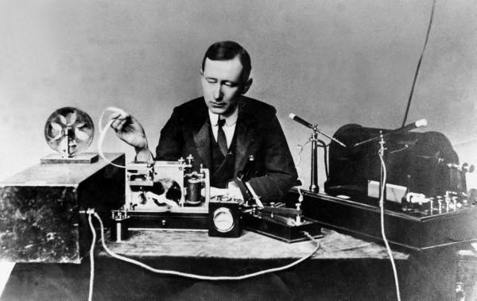
Technology and Innovation
Modern Canada feels the effects of new inventions such as cars, radio, and airplanes.
Guglielmo Marconi was the first guy to receive a text message in Canada---(well kind of; he received the first telegraphed message from England in morse code)
EXIT SLIP: How does technology and innovation contribute/influence a country?

