Slide 1
Mr. Chau’s 9th Lesson

Slide 2
It all began in 1401, when the people had began restoring Florence.
The outer dome was built for durability and security while the inner dome had beautiful paintings painted on it for a very beautiful and open effect.

Slide 3
Tip of the Day:
When writing sentences for a paragraph or an essay, try not to repeat a word more than once in the same sentence. Use a synonym.

Slide 4
IT’S I-CLICKER TIME!!

Slide 5
Question 1: Why did Italy form city states?
A) Because there were a lot of mountains that ran through the middle of the country.
B) Because different people wanted power in different regions (i.e. The Medici family)
C) Because it helps promote trade easier to start the Renaissance
D) Because it wanted to copy the Ancient Greeks.
E) All of the above.

Slide 6
Question 2: What is a city state?
A) The state of a city that tells you how bad the Black Death killed people.
B) Another word to say city but in the olden days.
C) An area surrounding a city that is controlled by their own government
D) All of the above

Slide 7
Question 2: Why did Italy start becoming more prosperous?
A) Because the Medici family has power.
B) Because the Black Death is over.
C) Because it was situated in the middle of the Mediterranean Sea.
D) Because people stopped having war in the region.
E) Because Filippo Bruneschelli just finished building the Santa Maria del Fiore.

Slide 8
Question 3: What region did the Medici Family control?
A) Siena
B) Rome
C) Florence
D) Venice
E) Naples

Slide 9
Question 4: Why was the Renaissance called “rebirth”?
A) Because the black death is over and the population started increasing again.
B) Because during this time the way people think changed.
C) Because people like the Medici Family sponsored people like Michelangelo to create new inventions.
D) All of the above.
E) None of the above.

Slide 10
Question 5: What is humanism?
A) A new way of thinking.
B) One of the biggest sources that teaches you information comes from the Bible. As people evolved through the centuries, they start to believe more about using reasoning to explain things rather than the Bible.
C) When a person starts to use more reasoning, they believe in themselves more and have confidence. This is when people start to value the things that they can do.
D) All of the above.

Slide 11
HUMANISM
But believing in yourself more DOESN’T mean they’re believing in God less. Humanism does NOT reject religious ideas.
Because they’re not rejecting religion this is when great things can be built using the ideas of human beings. (Santa Maria del Fiore)
Renaissance is all about change. Changing the way how people think. Changing the way how things look.
This includes art! They care about the humans more so painters and artists started to paint more that show human faces. Beautiful faces. Ugly faces.

Slide 12
Today’s Guiding Question
What technologies are there that help promote the spread of Renaissance ideas once they started booming in Italy?

Slide 13
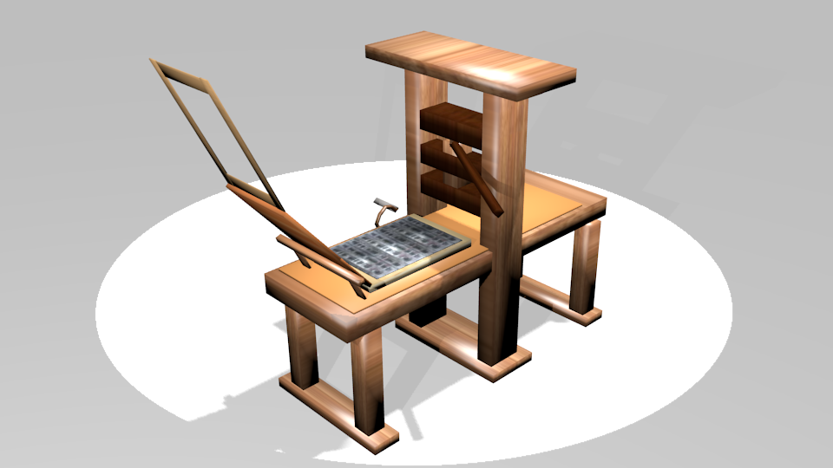
Printing Press

Slide 14
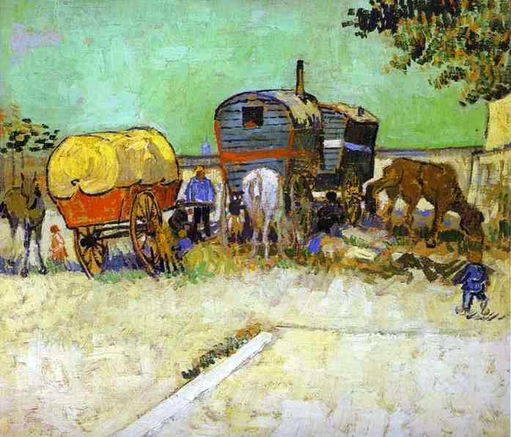
Caravans & Trade

Slide 15
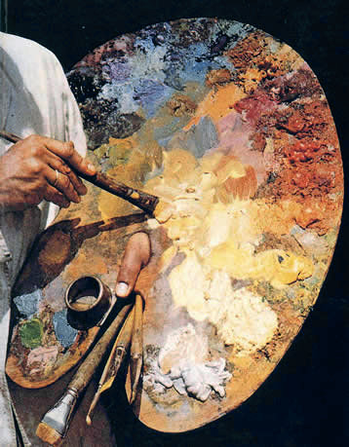
Oil Painting

Slide 16
Writers/Recorders
- you needed people to write and record these ideas to turn them into books for others to read.
- teamed up with the Printing press, the information gets bound into books and storage facilities (i.e. Libraries) started to emerge all over Europe as a means to store information.
- Traders would read and spread ideas around through the use of caravans. They will bring books and paintings using the oil paints to spread new perspectives of viewing the world and new ideas that come after.

Slide 17
Scientific Revolution
Remember what humanism is?
Reason helps expand knowledge about the natural world.
THINK, PAIR, SHARE.

Slide 19
The Reformation
http://www.history.com/topics/reformation/videos/protestand-reformation-english-reformation

